Slide 1
LDA Clusters

Slide 2
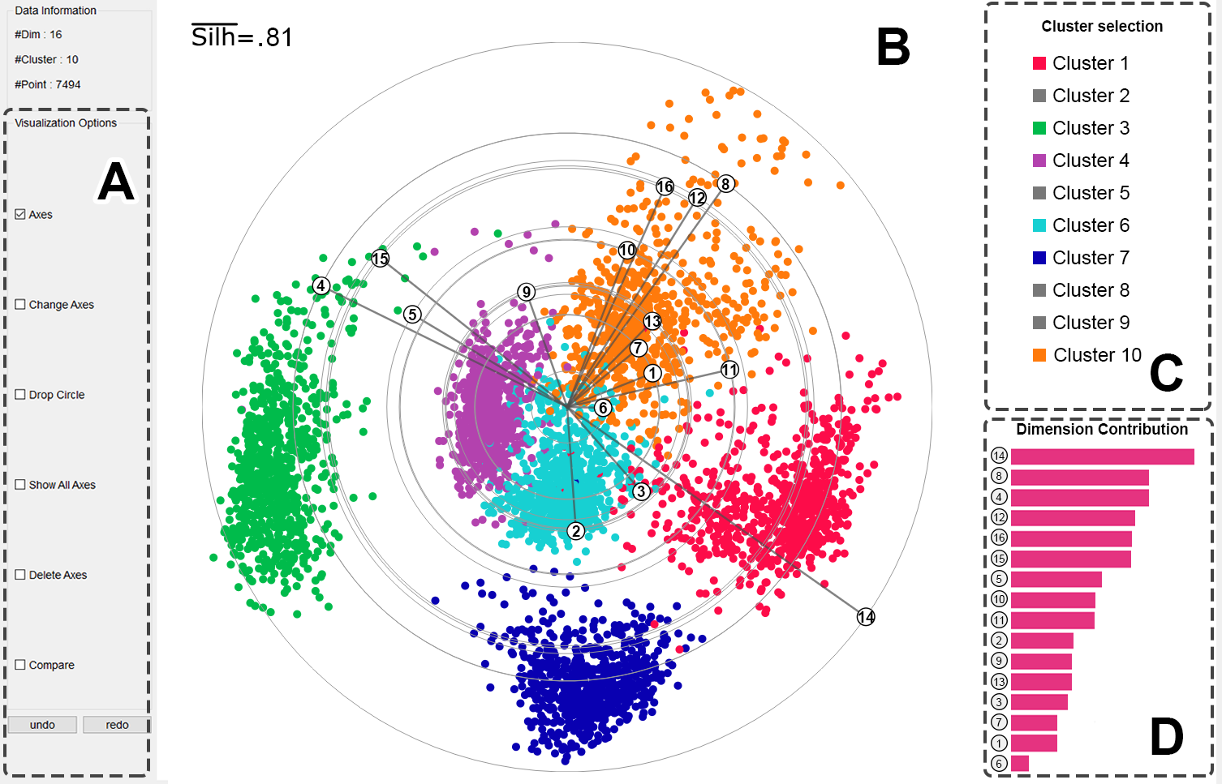

Slide 3


